Slide 1
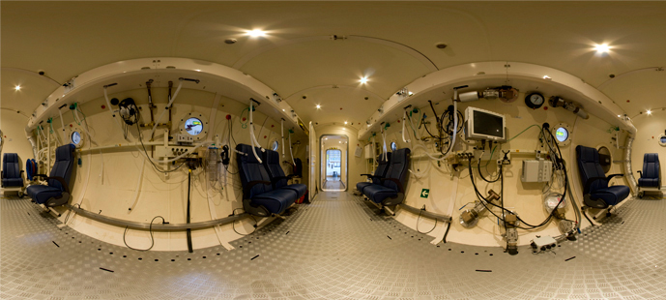
DDRC Healthcare – looking at things slightly differently… Illicit Drugs
Compiled by the DDRC Healthcare research department
www.ddrc.org
research@ddrc.org
facebook and twitter - @DDRCPlymouth
Notes:
This presentation has been put together by the DDRC Healthcare. It focuses on some of the real-life issues surrounding divers’ understanding of, and attitudes to, illicit drugs.
Some of the DDRC research findings are very revealing and DDRC hope that you as divers can have a better understanding, after this lecture, of the use of illicit drugs in the diving environment.

Slide 2
Illicit drugs
Why do we need to attend this presentation, and what will we learn?
Learn about illicit (recreational) drugs and understand how it may not be a good idea to “do drugs and dive”
Results of real research from DDRC concerning the use of illicit drugs by divers
Notes:
So why is it important to sit and listen about real life data – who does illicit drugs, what sort of drugs, and closest time to a dive and use of illicit drugs?
The answer is - as divers if you can hear and learn about what really happens, it will help you to be a more informed, safe and responsible diver.

Slide 3
Illicit Drugs
Anecdotally some divers are combining illicit drug use with diving activities
Little or no understanding within diving community
Residual/detection times
Interaction of drugs with diving environments
Physical and psychological effects
Notes:
We have known for a while now, anecdotally, that some divers use illicit drugs around the time of their diving activities.
But, how much do you in this audience actually know about illicit drugs?
Do you know about residual and detection times – for how long a certain illicit drug can have an affect on your body, or how long a drug can be detected in a urine test? Have you ever stopped to think about how an illicit drug may interact with the diving environment?
Do you know how a specific drug can affect you physically or psychologically?
Did you know that the strength of some strains of cannabis has increased by more than ten-fold since the 1980s? And that regular use of cannabis is linked with an increased risk of developing psychotic illnesses later in life, including schizophrenia. A family background of mental illness may increase the risk of developing a psychotic illness by using cannabis. It is also possible that frequent use of cannabis might affect the fertility of men and women – so think on that……
Did you also know - cocaine seized by the police in 2009 was on average only 33% pure, so if you don’t know how pure your cocaine is, you won’t know how strong it is, or what other substances you may be taking

Slide 4
Illicit Drugs
The National Data
The British Crime Survey (BCS) is the most reliable source of illicit drug data in the UK
In the 2007/8 survey 35.8% of 16 to 59 year olds had used illicit drugs in their life time
9.3% in the previous 12 months
5.3% in the last month
Cannabis/marijuana the most used drug
Notes:
But let’s look at the national data first.
In the UK the British Crime Survey is the most reliable source of illicit drug use in the national population, and a report is produced every year.
In 2007/8 – the period of time that relates to when the DDRC collected their data on illicit drug use in divers – the national data showed that over 35% of the population aged between 16 and 59 had used some kind of illicit drug during their lifetime, with just over 9% using an illicit drug in the last 12 months, and a little over 5% in the last month. And these findings are probably quite conservative.
As would be expected cannabis (marijuana) was the most used/popular drug.

Slide 5
Illicit Drugs
What DDRC researchers wanted to know…..
Investigate illicit drug use in UK sport divers
Type, class, and use of drug closest to time of diving
Notes:
So, the researchers at DDRC wanted to get a handle on the prevalence of illicit/recreational drug use in UK sport divers and launched a study called “The Health of Divers”. As well as asking the same type of questions as the British Crime Survey – frequency, type and class of drug – the researchers at DDRC also asked divers what was the closest time of drug use to a dive.

Slide 6
DDRC Research
Illicit Drugs
The Research Data
In 2007/8 DDRC collected data from 531 divers in a study called “Health of Divers”
68% males, 32% females
Age ranged 13-70 years (median 43)
More older males (48.9%) than females (31.6%)
45% of divers had more than 10yrs diving experience
388,209 dives (322,773 male, 65,436 female) since learning to dive
Notes:
The DDRC collected data from over 500 divers, from both men and women, across all age ranges, and all diving experiences. DDRC then compared the data they collected on illicit drugs use with the data from the national population – the British Crime Survey.

Slide 7
DDRC Research
Illicit Drugs
22% had used one or more illicit/recreational drug since learning to dive (62% males, 38% females)
3.5% used one or more drugs in the last 12 months
3% in the last month
Notes:
The national data (British Crime Survey) had asked the question “during your lifetime have you ever used illicit/recreational drugs”.
The DDRC changed this question and instead asked “since you learnt to dive have you ever used illicit/recreational drugs”. As you can see, the trends were similar to British Crime Survey. Though as you would expect and hope – there was less use of illicit drugs in divers than in the national population in all three categories.
However, 22% of the divers who took part in the DDRC project said that they had used one or more illicit drug since learning to dive compared with over 35% of the national population in their lifetime.
And …. More than 3% of the divers admitted to the use of one or more drug in the last 12 months, and 3% in the last month.

Slide 8
DDRC Research
Illicit Drugs
22% had used one or more illicit/recreational drug since learning to dive (62% males, 38% females)
3.5% used one or more drugs in the last 12 months
3% in the last month
Cannabis was the most used drug
Notes:
If we look at the type of drugs used by the divers, again the trends were similar to the British Crime Survey.
Cannabis was the most commonly used drug, with cocaine and ecstasy a close second and third!
There were even reports of LSD and magic mushrooms…..
POSSIBLE OPPORTUNITY FOR DISCUSSION HERE

Slide 9
DDRC Research
Illicit Drugs
22% had used one or more illicit/recreational drug since learning to dive (62% males, 38% females)
3.5% used one or more drugs in the last 12 months
3% in the last month
Cannabis was the most used drug
9% had used a class A drug since learning to dive
Notes:
Looking at the class of drug – again the trends seen in the class of drugs by divers broadly follow the national trend, with 9% having used a class A drug since learning to dive.
We will look at classification of drugs later in this lecture.

Slide 10
DDRC Research
Illicit Drugs
Some divers reported using more than one type of drug
Notes:
This chart shows the drugs reported, with some divers reporting the use of more than one type of drug. As you would expect cannabis was the most widely reported. It is interesting to see the range of drugs used by divers.

Slide 11
DDRC Research
Illicit Drugs
Some divers reported using more than one type of drug
Notes:
As you may know, drugs are also defined as hallucinogens or stimulants, and as would be expected hallucinogen (a majority of the drugs reported was cannabis) was the most frequently reported by divers.
In fact the majority of the drug use could be defined as hallucinogens, with some divers using both hallucinogens and stimulants, and a small number of divers using hallucinogens, stimulants and tranquilisers!

Slide 12
DDRC Research
Illicit Drugs
Some divers reported using more than one type of drug
Notes:
Drugs are classed as “A”, “B”, etc – with the same drug sometimes classed differently depending on the method of use. The majority of the drug use fell into class B as would be expected because of the high cannabis use, but it is also thought provoking to see that 40% of the drugs reported in the study were class A

Slide 13
DDRC Research
Illicit Drugs
Some divers reported using more than one type of drug
21% of the illicit drug group had used a class A or B drug between 5 minutes to 24 hours before diving
Cannabis, cocaine, and ecstasy were reported between 5 minutes and 6 hours before diving
40% Class A use
Notes:
21% of the divers who had reported using illicit drugs also admitted to using a class A or B drug between 5 minutes to 24hrs before a dive.
Cannabis (class B), cocaine (class A), and ecstasy (class A) were all reported between 5 minutes and six hours before a dive.

Slide 14
Illicit Drugs
What do you know about illicit drugs?
Detection time in urine
Residual time – time it stays in your body
Onset of effects – how soon you get a trip…
How it effects you physiologically
How it effects you psychologically
Notes:
So having seen what divers reported using in the way of illicit drugs – how much do any of you here today know about some of these drugs?
OPPORTUNITY FOR CLASS DISCUSSION HERE
Do you know about detection time in urine, residual time – time the drug stays in your body, onset of effects – how soon you get a trip…How it effects you physiologically, and how it effects you psychologically?
How will this affect you ability to dive safely?

Slide 15
Stimulants & Detection time in urine* | Onset/duration of effects* | Effects
Amphetamine 1 to 4 days UK Class A/B USA Schedule 2 | Rapid effect with intravenous and smoking use, slower by oral, overall effect 4 to 8 hours, residual up to 12 hours | CNS stimulation, increased heart rate, elevated BP, delusions, light sensitivity, anxiety, insomnia, irrational behaviour, delusions, headache
Cocaine 2 to 4 days UK Class A USA Schedule 2 | Within 5 minutes, with high lasting 15 to 30 minutes, general effects 1 to 2 hours, up to several days for late phase following a binge | CNS stimulation, elevated BP, increased body temperature, disorientated behaviour, euphoria, improved performance in simple tasks, dizziness, nausea and vomiting
Ecstasy (MDMA) Up to 4 days UK Class A USA Schedule 1 | Within 20 to 30 minutes, desired effect one hour, general effect 2 to 3 hours | CNS stimulation, relaxation, euphoria, changes in perception, impaired performance, visual disturbance, anxiety
Detection times of a drug in urine are often expressed in lower and upper limits because the times are dependent on a number of variables such as the amount and frequency of use, which is then related to drug tolerance, body mass index, overall health, age, metabolic rate, and urine pH. The times of detection and duration of effect shown here are therefore approximate.
Notes:
Let’s look at one or two of the drugs that divers reported taking ……
First of all stimulants - if we look at the left hand column…..
We can see that amphetamines, cocaine, and ecstasy are all stimulants.
Drugs are “classed”, but not all countries put drugs into the same classes as each other. For example cocaine is a class A in the UK but is a schedule 2 in the USA.
So we can see from the left hand column that amphetamines, cocaine, and ecstasy are all, in the UK, broadly class A drugs, and that detection time in urine can be anything from 1 to 4 days.
Now look at the middle column and see the timings of onset and duration of effects – and depending on what you have taken this can be from five minutes to several hours.
Moving over to the third column and looking at the effects – ask yourself how could any of these effects be compatible with a diving environment?
OPPORTUNITY FOR DISCUSSION HERE

Slide 16
Hallucinogens & Detection time in urine* | Onset/duration of effects | Effects
Cannabis/Marijuana 1 to 3 days but may be 20 days or longer UK Class B USA Schedule 1 | Within 10 minutes, high may last up to 2 hrs, behavioural and physiological effects return to baseline within 3 to 5 hours, residual effects in specific behaviours up to 24 hours | Increased cardiac output, vasodilatation, decreased coordination, impaired memory, euphoria, relaxed inhibitions, subjective slowing of time, apathy
LSD 2 to 5 days UK Class A USA Schedule 1 | Intravenous 10 minutes, oral 20 to 30 minutes with high at 2 to 4 hours and diminishing over 6 to 8 hours, flashbacks may occur within a few days or more than one year after use | Changes in perception and mood, decreased coordination, subjective slowing of time, hypertension, increased heart rate, panic attacks, loss of personal boundaries
Magic mushrooms (Psilocybe & Amanita Muscaria mushrooms) Approx 8 hours UK Class A USA Schedule 1 United Nations 1971 Convention on Psychotropic Substances | Within 30 minutes to 2 hours, high at about 4 to 10 hours, after effects a further 2 to 6 hours | Increased confidence, distortion of colour, sound and objects, changes in sense of time and movement
Notes:
Next hallucinogens – looking at the left hand column…..
We can see that cannabis, LSD, and magic mushrooms are all hallucinogens.
And that cannabis is a class B, and that LSD, and magic mushrooms (raw or cooked) are class A drugs, and just look at the detection time in urine - which can be anything from one day up to 20 days.
Now look at the middle column and see the timings of onset and duration of effects – and depending on what you have taken this can be from ten minutes to several hours, or in extreme cases with LSD a lot longer time span .
And again, moving over to the third column and looking at the effects – ask yourself - how could any of these effects be compatible with a diving environment?

Slide 17
Opiates | Onset/duration of effects | Effects
Heroin 2 to 3 days UK Class A USA Schedule 1 | Dependent on route and dosage, from 45 seconds to several minutes, peak effects 1 to 2 hours, overall effect 3 to 5 hours | CNS depression, light-headedness, reduced respiratory rate, dizziness, euphoria, nausea and vomiting, sedation, intense euphoria, mental clouding
Depressants Sedatives/Hypnotics | Onset/duration of effects | Effects
Barbiturates Short acting 1 day Long acting 2 to 3 wks UK Class B USA Schedule 3 | Long acting effect within 1 to 2 hours, total effect 12 hours or longer | CNS depression, cardiovascular system depression, decreased mental acuity, euphoria, depressed respiratory function, anxiety suppression
Notes:
And lastly – looking at heroin and barbiturates, class A and B respectively – you can see a similar set of timings of detection, onset, and a similar set of physiological and psychological effects to all the other drugs we have just discussed.
Would you want to go diving with anyone who had been taking any of these drugs?
OPPORTUNITY OF DISCUSSION HERE

Slide 18
DDRC Research
Illicit Drugs
The timings before diving of some drug use should be of concern to the educators in the diving industry
Cannabis (B), cocaine (A), and ecstasy (A) use reported 5 minutes to 24 hours before a dive
The effects of cannabis start within 10 minutes, a high can last up to 2 hrs, and residual effects in specific behaviours evident up to 24 hours
Are divers potentially increasing the risk of a diving incident?
Notes:
So – bearing in mind all the effects of the drugs and the results of the data – do you think the timing of a dive and illicit drug use should be of concern.
Of special concern is the length of time that the “hidden” effects some of the drugs may have – and this prompts the question “are divers who take illicit drugs around the time of their diving activities increasing the risk of a diving incident?”
OPPORTUNITY FOR DISCUSSION HERE

Slide 19
Illicit Drugs
This real life research shows that divers do use illicit drugs around the time of their diving
Don’t put yourself and other divers at risk
Don’t do drugs and dive
Notes:
One thing is certain – the data collected by DDRC shows that some divers do “do drugs” and that the time for “pretending it doesn’t happen” is past.
Don’t put yourself and/or your buddy at risk and do “drug diving” – think of the detection times, residual times, and the physiological and psychological effects – think before you “drug dive”.

Slide 20

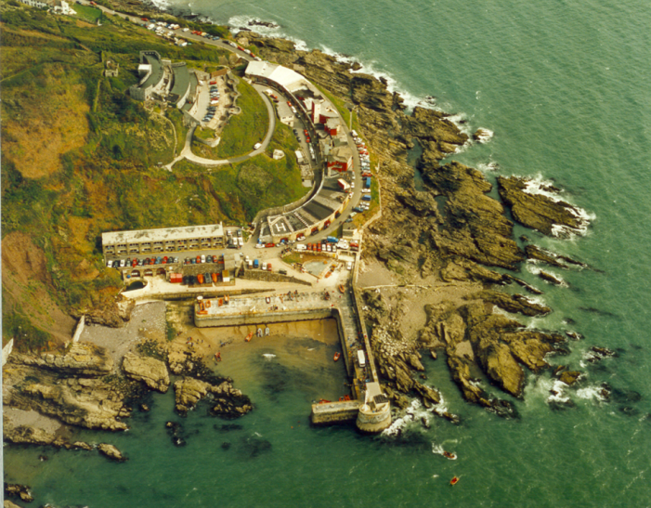

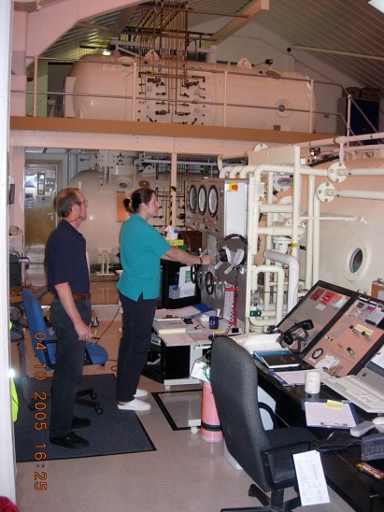
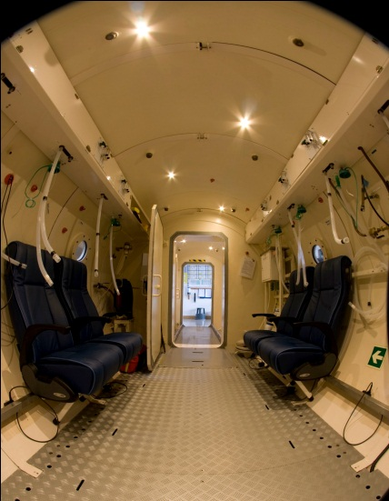
Who and What is DDRC Healthcare?
Not for profit charitable organisation
Founded over 30 years ago
Emergency recompression
Fitness to dive advice
Medicals
Education
Research
Hyperbaric oxygen therapies
Notes:
DDRC Healthcare would like to thank you for using this presentation and hope that you have found it informative. If so, please tell your diving friends about us, the work we do, and the services we provide.
All our diving research relies on funding from our charitable status, so we would appreciate you, or your club/school, making a donation for the use of this presentation, if you feel able.
Thank you so much!
DDRC Healthcare is a registered charity (No 279652)

